Slide 1

Pin Me!
Group :5
Shivanagesh Chandra
Prathyusha Rani
Prathyusha
Divyarajalakshmi

Slide 2
Need?

Slide 3
Applications
We created this project to give an open
source module for non profit organizations
to use as platform for their activities.
Pin Me is the destination for you to find out
your local events happening around
you(Entertainment,food,books distribution)
Publishing your events

Slide 4
Technologies used
Data base UI Server
Mysql HTML5 Apache Tomcat8
Jdbc4 CSS
Bootstrap
Javascript
Jquery

Slide 5
Use Cases

Slide 6
Component Diagram

Slide 7
Sequency Diagram

Slide 8
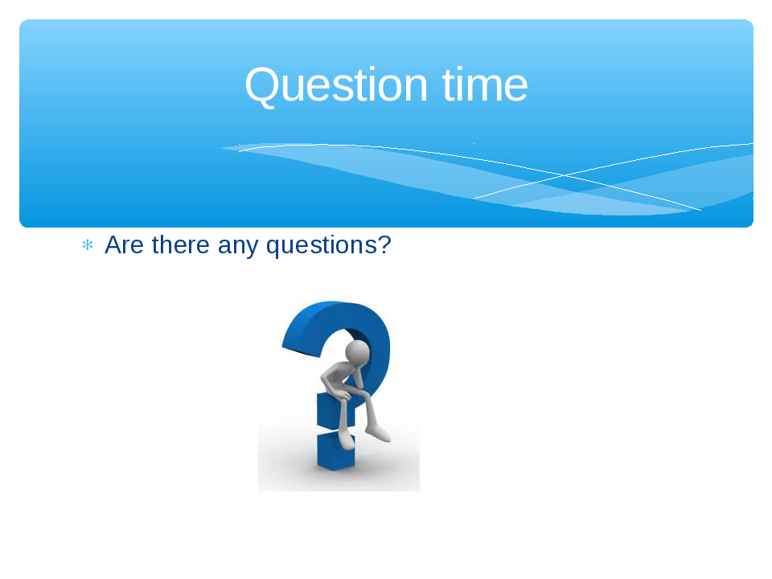

Slide 9
Thank You!

